Slide 1
Docker Introduction

Slide 2
What is Docker?
Docker is an open-source containerization platform by which you can pack your application and all its dependencies into a standardized unit called a container.
Containers are light in weight which makes them portable and they are isolated from the underlying infrastructure and from each other container.
You can run the docker image as a docker container in any machine where docker is installed without depending on the operating system.

Slide 3
Why Docker is popular?
Portability
Reproducibility
Efficiency
Scalability

Slide 4
Docker Key Components
Docker Engine:
It is a core part of docker, that handles the creation and management of containers.
Docker Image:
It is a read-only template that is used for creating containers, containing the application code and dependencies.
Docker Hub:
It is a cloud based repository that is used for finding and sharing the container images.
Dockerfile:
It is a script that containing instructions to build a docker image.
Docker Registry :
It is a storage distribution system for docker images, where you can store the images in both public and private modes.

Slide 5
Terminologies
Docker Image
Read-only templates that contain instructions for creating a container.
A snapshot or blueprint of the libraries and dependencies required inside a container for an application to run.
Docker Container
A container is a runnable instance of an image.
You can create, start, stop, move, or delete a container

Slide 6
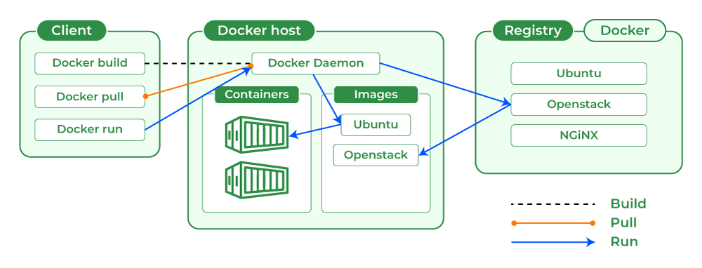
Docker Architecture
Uses a client-server architecture.
The Docker client talks with the docker daemon which helps in building, running, and distributing the docker containers.
The Docker client runs with the daemon on the same system or we can connect the Docker client with the Docker daemon remotely.
With the help of REST API over a UNIX socket or a network, the docker client and daemon interact with each other.

Slide 7
Terminologies
dockerfile
Docker can build images automatically by reading the instructions from a Dockerfile.
A Dockerfile is a text document that contains all the commands a user could call on the command line to assemble an image.
This page describes the commands you can use in a Dockerfile.

Slide 8
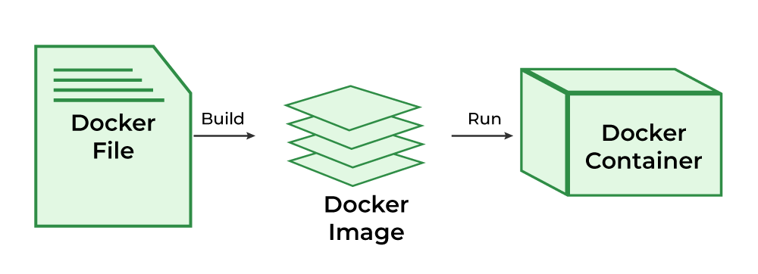
Terminologies

Slide 9
What is Docker Hub?
A repository service.
It is a cloud-based service where people push their Docker Images.
Also you can pull the Docker Container Images from the Docker Hub anytime or anywhere via the internet.
You can push your images as private or public registry where you can store and share Docker images.
It is an open-source tool and freely available for all operating systems.
It is like storage where we store the images and pull the images when it is required.
To push images to docker hub you need an account with docker hub.

Slide 10
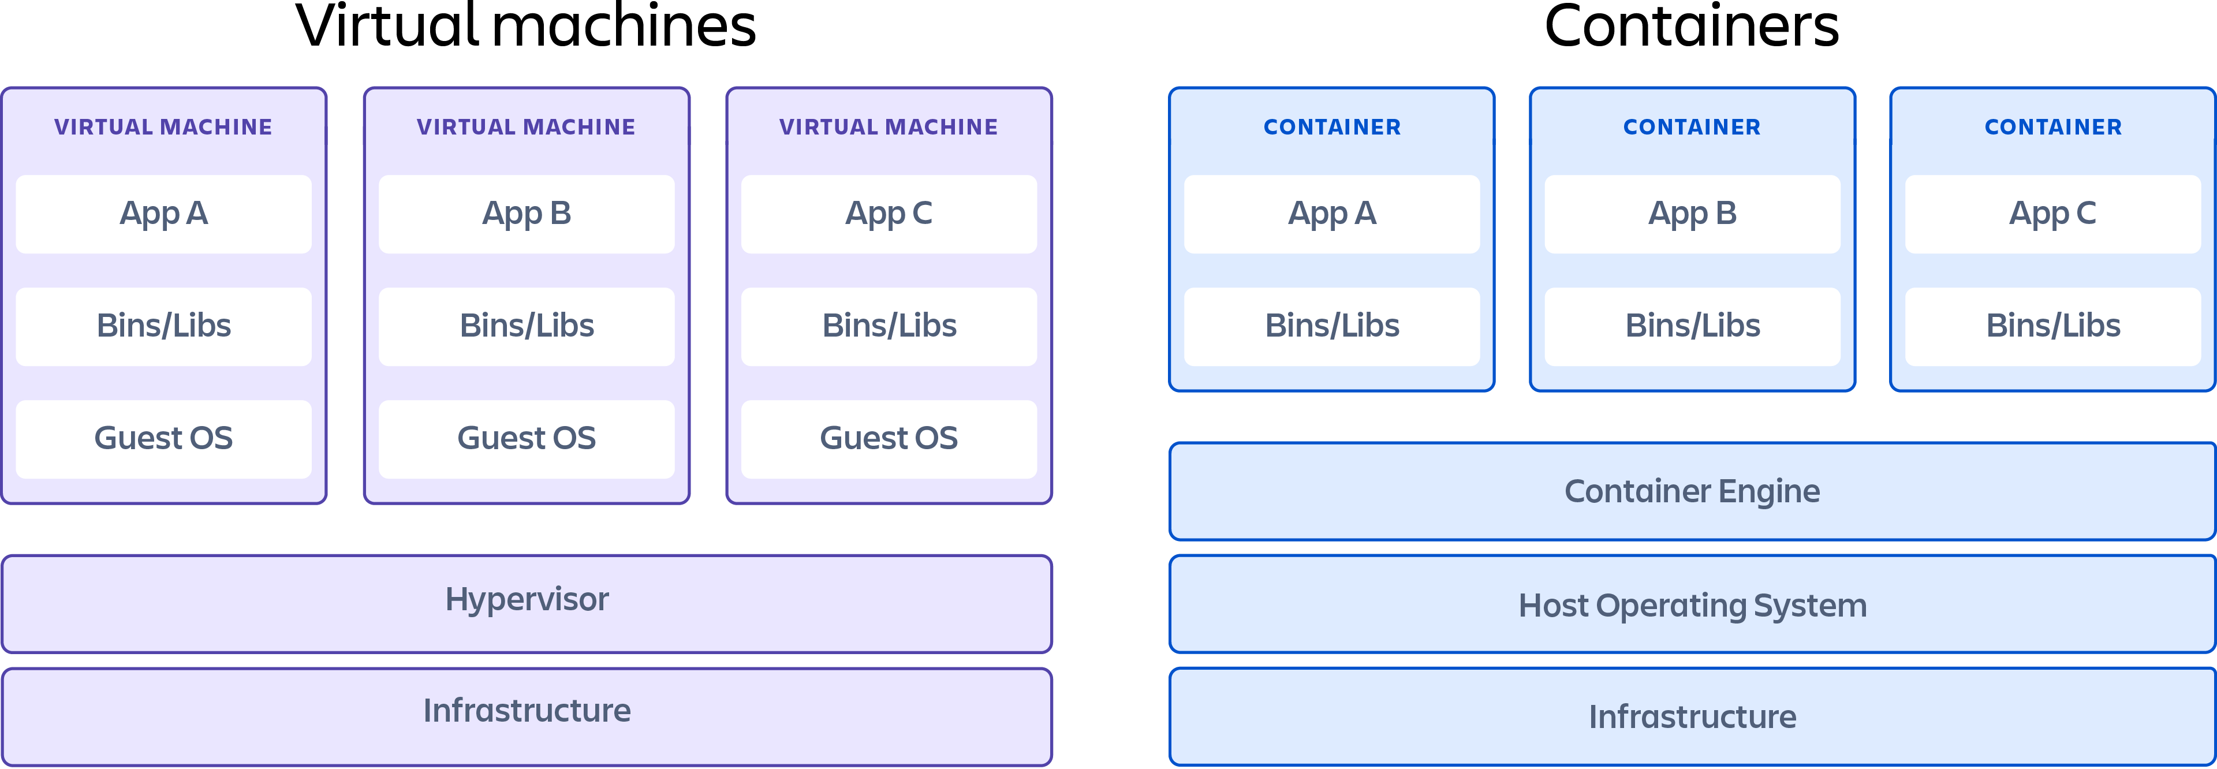
Virtual Machines vs Containers

Slide 11
Virtual Machines vs Containers
Feature | Container | Virtual machine
Operating system | Shares the host operating system's kernel | Has its own kernel
Portability | More portable | Less portable
Speed | Faster to start up and shut down | Slower to start up and shut down
Resource usage | Uses fewer resources | Uses more resources

Slide 12
Docker vs Kubernetes
Characteristics | Kubernetes | Docker
What is it? | Container orchestration tool. | Stack of container technologies to create and run containers.
Use | Coordinate multiple containers across multiple servers. | Package applications with libraries and runtime into container images.
Main benefit | Define and run complex containerized applications at scale. | Standardize application operations and ship code faster.

Slide 13
Get started
How to run Docker commands? Two ways
Terminal/cmd (CLI)
Docker Desktop (GUI)
In Docker CLI
docker run hello-world
First the image hello-world is searched in the local docker, if not then it is pulled from docker hub and run.
docker run –it ubuntu
Ubuntu OS container is created in interactive mode.
We can type OS commands here.
Type exit to come out of the container
Start exploring the different official images in the docker hub website and play with them.

Slide 14
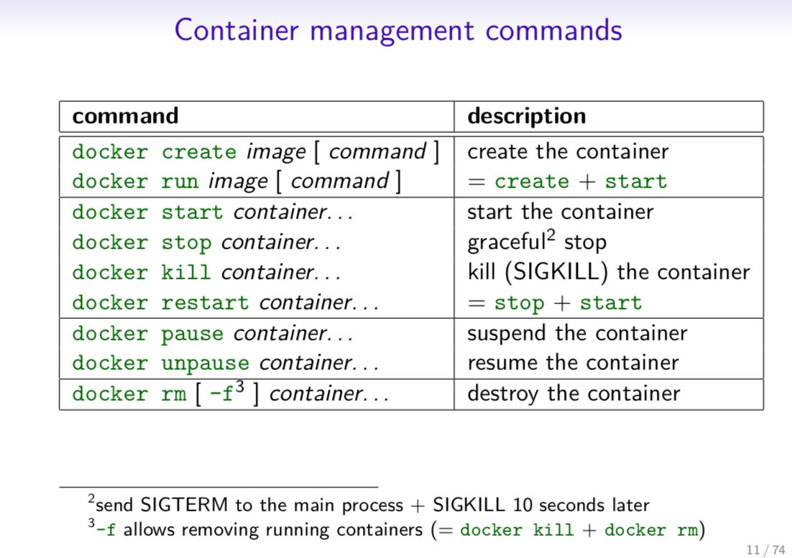
Docker Commands

Slide 15
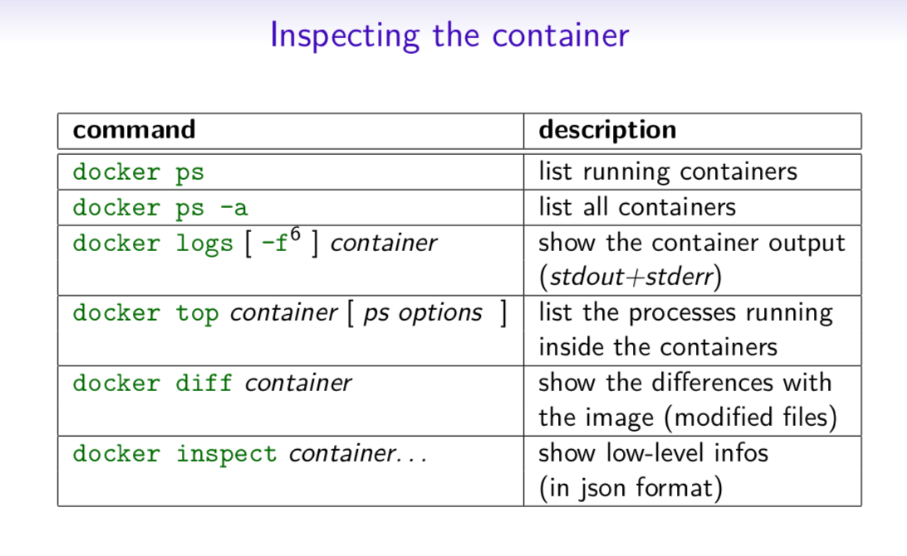
Docker Commands

Slide 16
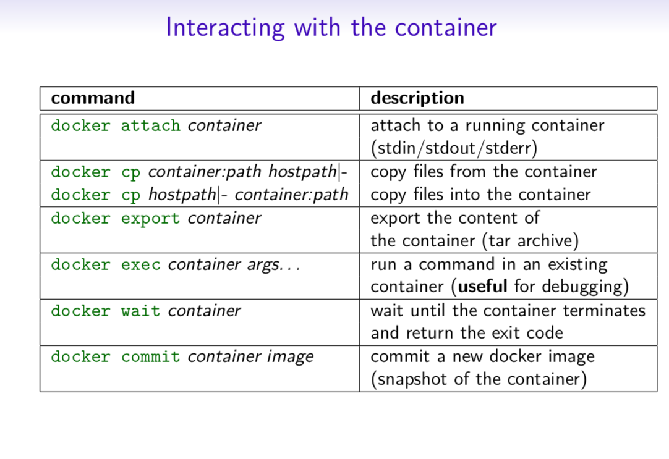
Docker Commands

Slide 17
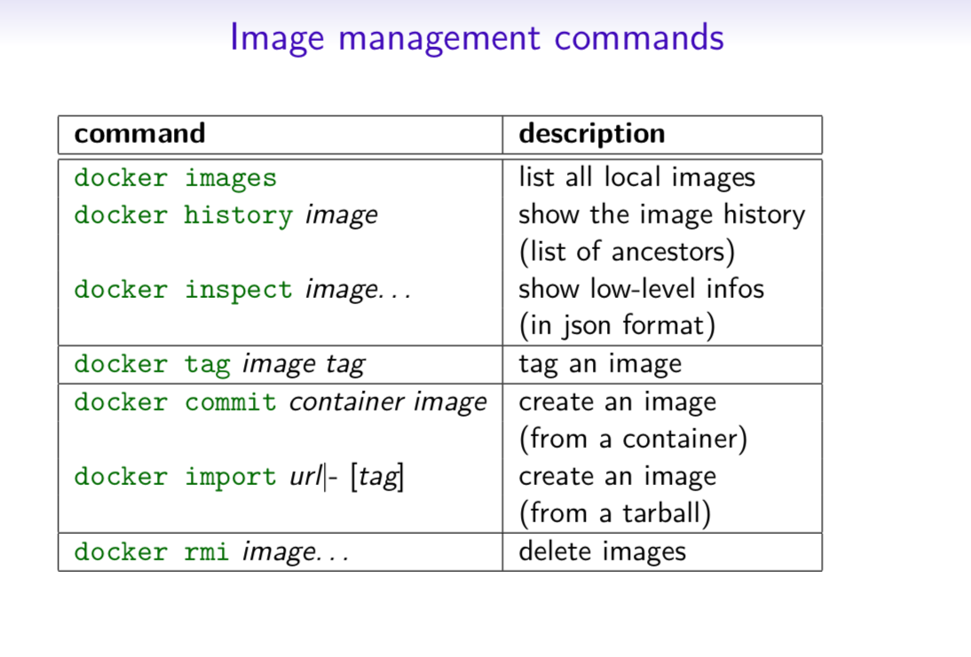
Docker Commands

Slide 18
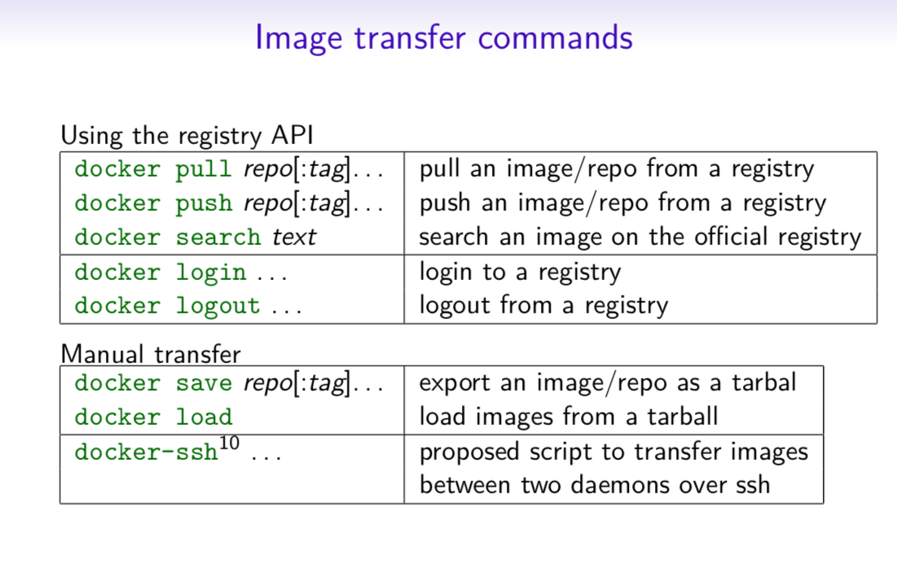
Docker Commands

Slide 19
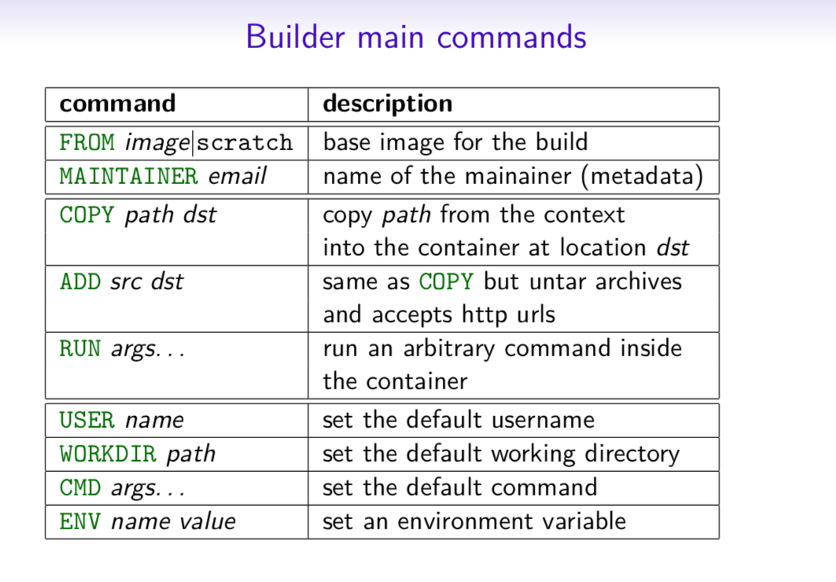
Docker Commands

Slide 20
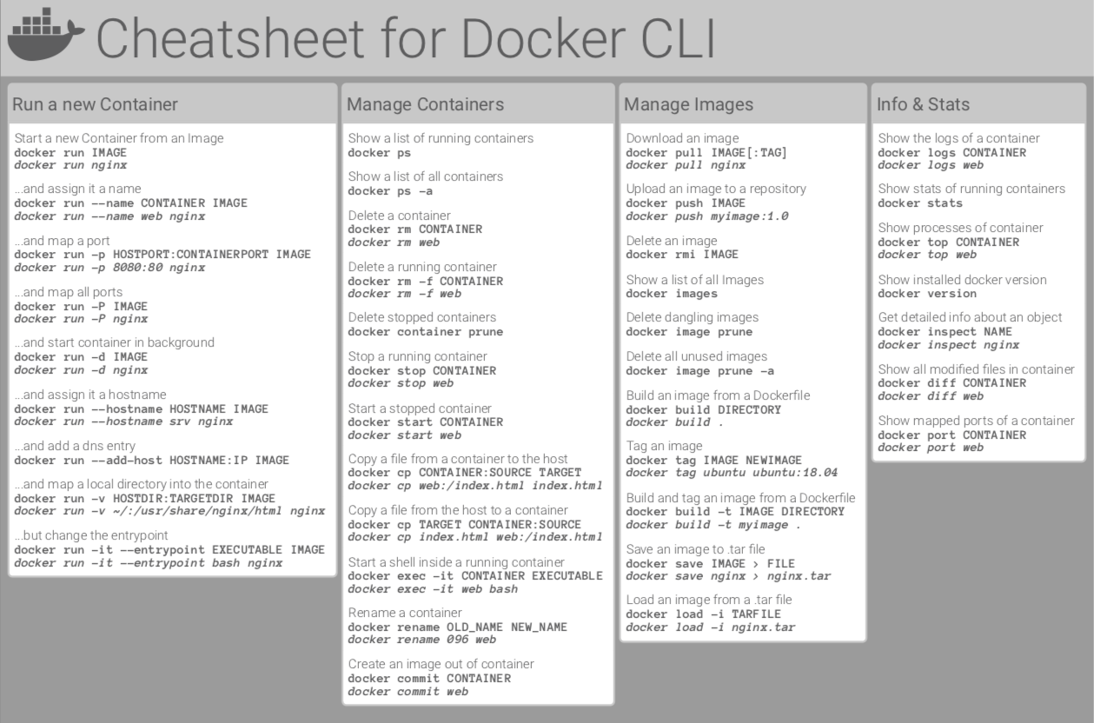
Cheat Sheet for Docker CLI Basic Commands

Slide 21
Using mongo db image
First create a network.
docker network create -d bridge some-network
The mongo db server container and the mongo sh(client) container can interact by referring the same network name.
Next start the mongo db server container
docker run --name some-mongo --network some-network -d mongo
Next start mongosh(client CLI) to interact with the mongo server
docker run -it --network some-network --rm mongo mongosh --host some-mongo test
Now run mongodb commands
show dbs, use <dbname>, show collections, db.createCollection('Student’), db.myNewCollection1.insertOne( { name:“abc" } )

Slide 22
Using nginx image
Create a html file test.html in D:/demo folder
Two ways
Run the docker command to create the container from the image nginx
docker run --name some-nginx -v D:/demo:/usr/share/nginx/html –p 8888:80 -d nginx
Using dockerfile
Alternatively, a simple Dockerfile can be used to generate a new image that includes the necessary content (which is a much cleaner solution than the bind mount above):
FROM nginx
COPY static-html-directory /usr/share/nginx/html
Place this file in the same directory as your directory of content ("static-html-directory"), run docker build -t some-content-nginx ., then start your container:
docker run --name some-nginx -d some-content-nginx
Type the url http://127.0.0.1:8888/test.html , the page should be displayed
Also you can enter into the nginx container to see the mounted files
docker exec -it some-nginx bash
Next navigate to usr/share/nginx/html

Slide 23
Excercise
Similar to mongo and mongosh image try for postgres.

Slide 24
END

